Slide 1
Shift-Left Security:
More than just a catchphrase
Vince King
October 2023
Notes:
Shift-left Security: More than just a catchphrase
Vulnerabilities like Log4j may be headline grabbers, but thousands of applications are being targeted by hackers who use flaws in code as attack vectors. Vulnerabilities such as cross-site scripting and improper authorisation are on the increase, and with the increased use of open source software we need to ensure "shift-left security" is more than just a catchphrase.
During this presentation we'll look at:
- what modern development looks like
- what developers want
- what developers actually need
- what IT professionals should look for in DevSecOps tooling and how it can help

Slide 2









#whoami
Vincent King
Senior Cyber Analyst
Head of DevSecOps
Bank of England
Reformed Developer
Secure Coding Subject Matter Expert
(ISC)² Certified Information Security Professional
Chartered Fellow of the BCS
DevSecOpsVince
vincentjking

Slide 3




DevOps vs Security – The Perception
Dev
Dev
Sec
Ops

Slide 4





Scary Slide No.1

Slide 5
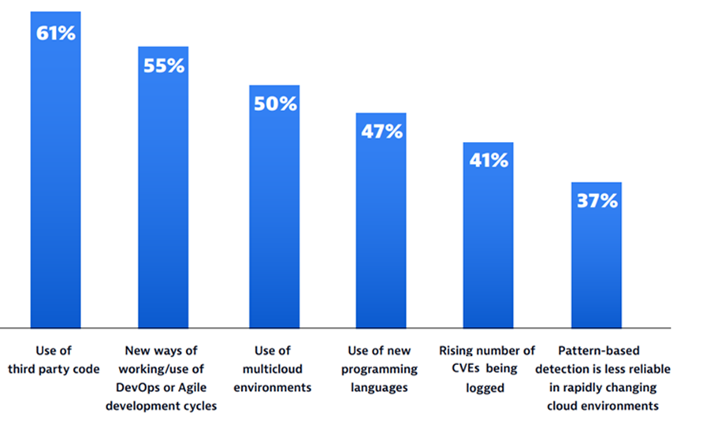
Scary Slide No.2
68%
of apps had a security flaw that fell into the OWASP Top 10

Slide 6
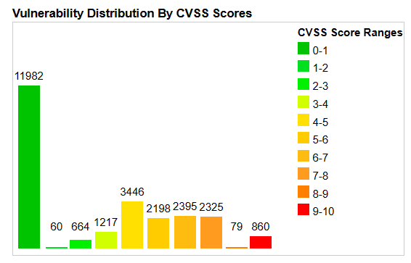
Scary Slide No.3
25,226
Common Vulnerabilities and Exposures (CVEs) were published last year alone.
57%
report that their breaches could have been prevented by installing an available patch
34%
victims knew of the vulnerability, but hadn’t taken action

Slide 7

Where should Sec live?
Sec
Sec
Sec
Ops
Dev
Security Everywhere

Slide 8



Vince’s Three “i”s of Tooling for Developer Enablement
Integrations
Intelligence
Insights
IDEs
Pipelines
Policies
Audit Mode
Speed
Sources
Zero days
Recommendations
Vendor data
Communication
Prioritisation
Custom Code/SBoM
Licences
Trending
Enterprise Visibility

